Slide 1

DEPARTMENT OF TECHNOLOGY, SHIVAJI UNIVERSITY, KOLHAPUR
Presentation on Major Project

Slide 2
Project Title Robotic Spider Bot
GUIDE- Smt. Nikam L. S.

Slide 3
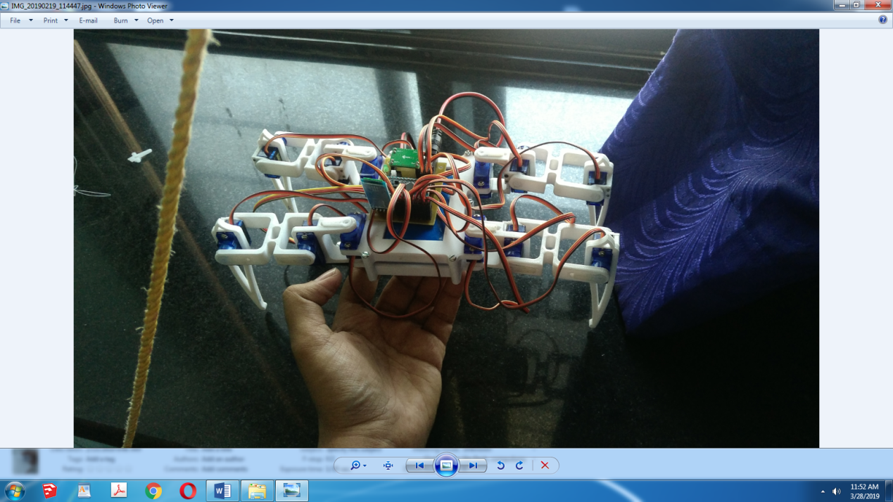

Slide 4
Project Definition-
Four legged robot or Spider Robot is a basic representation of the spider.
It has 3 Degrees of Freedom for each leg with 4 legs making a total of 12 DOFs.It can have 4/6/8 legs.
With better understanding of legged locomotion and movement capabilities, motion algorithms can be improved to mimic more natural dynamic movement modeled after animal gait patterns. Can be used for to collect data during exploration when drones cant reach at that place.
Their abilities can be expanded to rescue operations, unmanned exploration like mines, pack-mules, and military operations like bomb diffusion ,mine detection or under radar surveillance
Legged robots handle terrain better than their wheeled counterparts and move in varied and animalistic ways

Slide 5
Objectives
To create a Proof of Concept robot that is able to explore environments unsafe for humans such as in case of fires ,chemical leaks, hazardous atmospheric areas ,radiation prone zones
To program mechanical components(such as servo motors) using softwares.
Four legged robots are statically stable and the walking pattern of a four legged robot can be designed in different ways.
To create a robot that could send us information regarding these areas where aerial robots are inaccessible
To study the Dyanamics of a walking robot.
To depict use of Creep Gait or 1 leg pull,3 legs push

Slide 6
Advantages
Exploring environments unsafe for humans such as in case of fires,chemical leaks,hazardous atmospheric areas or radiation prone zones.
Quadruped robots have a large number of real life applications, from crossing potentially dangerous terrain to carrying out search and rescue operations in hazardous and unpredictable disaster zones (Karalarli, 2003). They have a number of advantages over wheeled, quadruped or bipedal robots:
Legged robots offer more control over wheeled counter parts on uneven terrains
These have spot turning mechanisms
These cheaper bots find application in swarm robotics

Slide 7
Methodology
Mechanical design required us to limit shapes to offer contact reaction less than 250 gm per leg with actual weight being 427gm
Electrical design required us to limit voltages to 5V for efficient heat management without adding a servo controller
Use of servos as prime movers.
A Bigger Model can be manufactured reusing the existing code
Use of light weighted power banks or cells as powersource,a bluetooth module to control its movement via a pc or mobile has been done.
Use of Arduino pro mini as microcontroller

Slide 8
Future Scope
This robot can be upgraded for a bigger , better industrial variant.
Use of artificial intelligence and machine learning to train it for working on rough terrains.
Making the bot use practical on field,and in exploration is a big challenge and requires input by engineers of many streams to work together to make the bot use its full potential.
Since this is a largescale project and many functions such as its ability to traverse heights,self balance itself over uneven surfaces or ability to detect and avoid obstacles are some of the features that perhaps could be worked upon.

Slide 9
Fabrication
Fabrication of circuit board is done by 3rd party vendors but the PCB is designed by us.
The body is completely printed using our college’s 3D printer(Raise3D V2 N2 HotEnd ).Parts were designed using SketchUp CAD software and Ideamaker as Slicer,while using EaglePCB for pcb design.
The Code was ported from a robot simulation done by Sunfounder (Hexapod in Python) and our code was built using their inverse kinematics calculations and modified to work for our four legged variant into C++.

Slide 10
Conclusion
It is inexpensive in terms of all resources while also being accessible to new users.
This new platform is intended to advance the field of swarm robotics by facilitating a greater volume of concerning collective behavior, and allow for collective robotic behavior.

